Slide 1
Smart Pisciculture User Recommendation System
(SPURS)
Authors
Presented by
Dr. R. Sriranjani, SAP
Dr. N. Hemavathi, APIII
Kesava Satish Boppana, UG student
S Akkshya Balaji, UG student
B.H.V.G.Saisriram, UG student
Kesava Satish Boppana,
School of EEE,
SASTRA Deemed to be University,
Thanjavur
School of EEE,
SASTRA Deemed to be University,
Thanjavur

Slide 2
Presentation Outline
Abstract
Introduction
Proposed approach
Result and Discussion
Conclusion
Reference

Slide 3
Abstract
The objective of the project is to simplify the crucial and tedious processes of monitoring and collecting data from water bodies and surrounding ecosystems.
It is achieved by automating these processes through the implementation of the Internet of Things (IoT).
The proposed system will provide essential information about water conditions and factors that influence the growth of fish and shrimp.
Recommendations will be generated based on real-time data from the fisheries, enabling farmers to make data-driven and timely decisions to prevent any mishaps

Slide 4
Introduction
Pisciculture involves rearing fish on a large scale for food consumption. However, due to limited awareness and scarce technical and scientific development in the field, the final yield or annual production from fisheries often fails to meet existing food demands.
This problem can be addressed with a simple yet crucial methodology that involves periodic monitoring and data collection, tasks that are often tedious

Slide 5
Proposed approach
To implement the IoT aspect of this project by utilizing various necessary sensors crucial to the collection of essential information to be analysed.
The sensors taken into consideration are temperature, Turbidity, dissolved solids, depth, pH and Dissolved Oxygen (for BOD).
These sensors work in tandem in order to deliver and store the data to a cloud based service for pre-processing and analysis.
The IoT cloud platform used here is Thinkspeak, which offers database management.
The data is retrieved from the database in the form of a report upon request from the user via an API or it can be seen in real-time from the API and in case of emergency an alert prompt or message is delivered

Slide 6
The system utilizes an Arduino Mega and ESP32 to gather sensor data and transmit it to the cloud-based platform ThingSpeak for analysis and visualization.
The system consists of an Arduino Mega and ESP32, which work together to collect and transmit data from six different sensors.
The Arduino Mega serves as the central unit for data collection, while the ESP32 handles the communication with ThingSpeak.
The ESP32 module is responsible for establishing a connection to the cloud-based platform ThingSpeak. Using its communication capabilities, the ESP32 securely transmits the collected data to the ThingSpeak platform.
The parameters considered are temperature, pH, turbidity, dissolved oxygen, depth and dissolved solids for monitoring and providing data as these attributes are very crucial for uninhibited growth of fishes.
These six attributes are constantly monitored with the help of 5 sensors to provide real time data when connected with ESP-32 which is in turn connected with the thinkspeak API and hence can deliver the real time data to the cloud

Slide 7
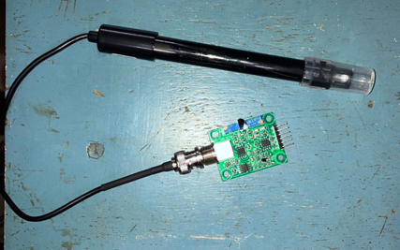
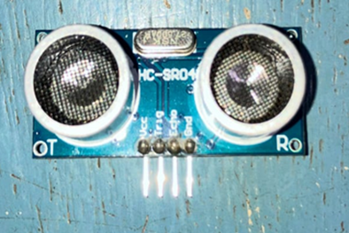
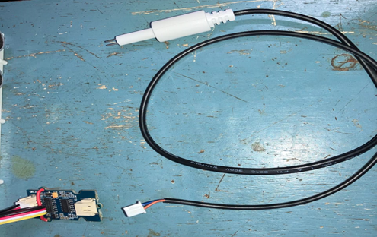
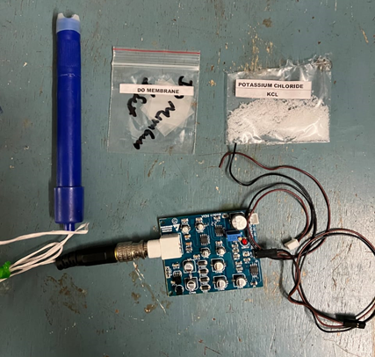
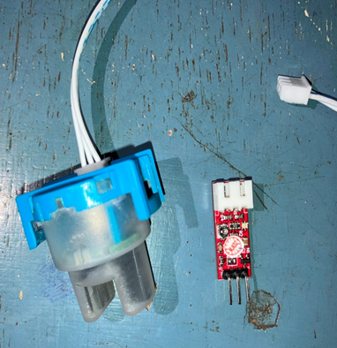
Sensors
pH & temperature sensor
Depth sensor
Dissolved Solids Sensor
Dissolved oxygen sensor
Turbidity Sensor

Slide 8
Work flow
Pre-processing data and storing in cloud
Handling of processed data via an IoT tool
Acquisition of Data
Hosting of website and Application to monitor the ecosystem
Deliver the test results upon request or at real time and sending alerts
Deploying the sensors in water body.
Request by user via the Application interface

Slide 9
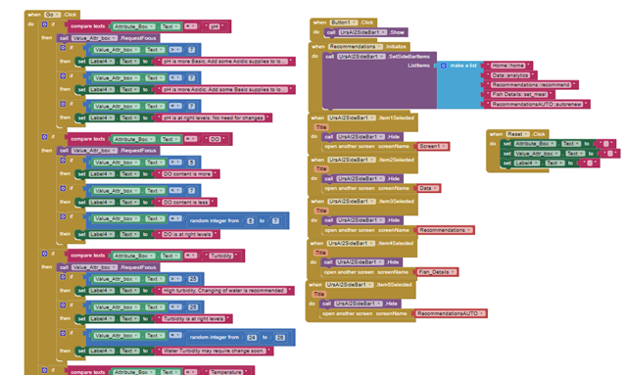
Recommendation system
The recommendation system is made with the use of MIT app inventor, with a drag and drop functionality.
The Code for the SPURS app was done in a block connection method where each and every block represents a syntax

Slide 10
The recommended system was divided into two types, first one being a manual one which anyone with data in their hand can make use of.
The second recommendation system was an automatic one, which based on the real time data acquired from the IoT, gives out suggestions regarding the condition of the water body.
The second system requires the user to have created an Thinkspeak account which is connected to their IoT implementation.
This Automated system updates the real-time data in the think speak server which can be viewed from the SPURS app.
The manual Recommendation system on the other hand does not require any IoT setup or sensors connected with thinkspeak.
These Manual recommendation systems can be used with the help of any data related to the fish farm, be it in the form of reports or data from tests.

Slide 11
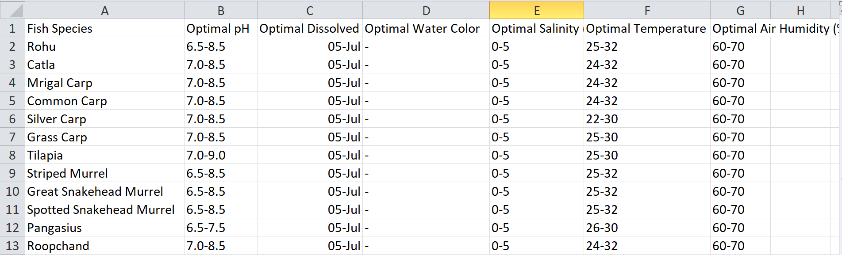
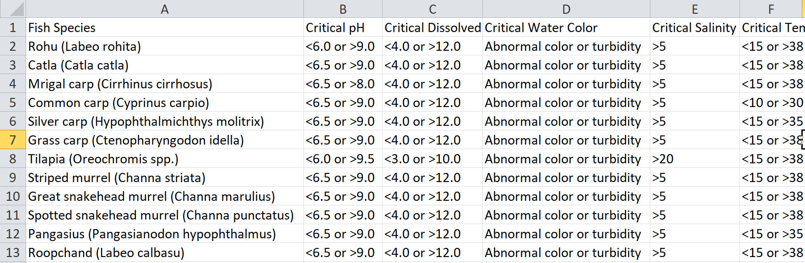
Data Sets
Data set for species of fish recommended for Ministry of fishery to be grown Commercially
for consumption. Here these values represent the Optimal growing condition for the fishes.
The Threshold values of each attributes which are taken into condition for deploying respective sensors. Exceeding the threshold values or the values being less than the optimal values results in stunted growth of the fishes.

Slide 12
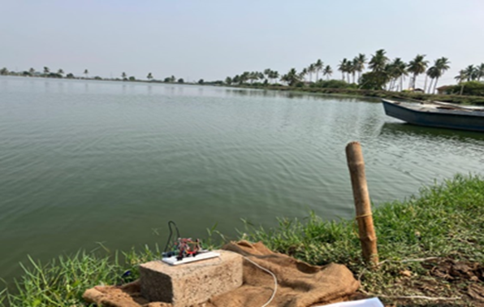
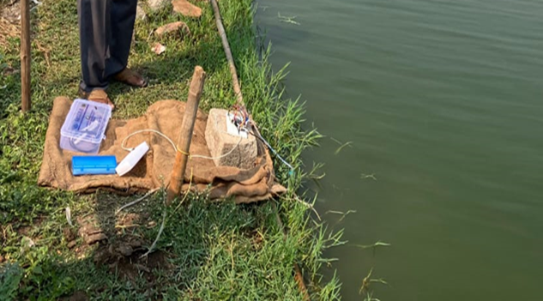
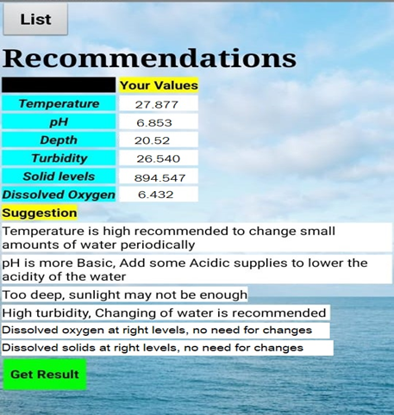
Results and Discussion
The model has been successfully developed and deployed within an IoT system designed to collect real-time data from the fish farm.
Additionally, a mobile application has been developed to provide suggestions based on the real-time data gathered by the IoT system. This app also helps farmers make data-driven decisions

Slide 13
Conclusion
This project has successfully simplified the monitoring and data collection processes in water bodies and their surrounding ecosystems by leveraging the capabilities of the Internet of Things (IoT).
The newly implemented system automates these previously labor-intensive tasks, providing continuous, real-time data on water conditions and other environmental factors critical to the health and growth of fish and shrimp populations.
The information generated by this system enables fishery operators to make well-informed, timely decisions, enhancing the sustainability and productivity of their operations. By ensuring that these decisions are based on precise, up-to-date data, the project not only minimizes the risk of ecological mishaps but also supports a more efficient and productive aquaculture industry.
This approach demonstrates a significant advancement in environmental monitoring technologies, offering a model that can be replicated in other sectors seeking similar improvements in data-driven management practices.

Slide 14
References
IoT-Based Fish Farm Water Quality Monitoring System by Chiung-Hsing Chen 1,Yi-Chen Wu ,Jia-Xiang Zhang and Ying-Hsiu Chen , Department of Electronic Communication Engineering, National Kaohsiung University of Science and Technology, Kaohsiung 811213, Taiwan and Microchip Technology Inc., Chandler, AZ 85224, USA
IoT Based Automated Fish Farm Aquaculture Monitoring System by Sajal Saha, Rakibul Hasan Rajib and Sumaiya Kabir, Conference: 2018 International Conference on Innovations in Science, Engineering and Technology (ICISET)
An efficient and smart IoT based pisciculture for developing countries by P. Veeralakshmi, S. Sowmya, K. Nattar Kannan, S. Anbu, and G. Ayyappan, on AIP Conference Proceedings.
Development of smart aquaculture farm management system using IoT and AI-based surrogate models by Min-Chie Chiu , Wei-Mon Yan , Showkat Ahmad Bhat , Nen Fu Huang Department of Mechanical and Materials Engineering, Tatung University, Taipei, Taiwan, ROC Department of Energy and Refrigerating Air-Conditioning Engineering, National Taipei University of Technology, Taipei, 10608, Taiwan, ROC College of Electrical Engineering and Computer Science, National Tsing Hua University, Hsinchu, 300044, Taiwan,

